Slide 1
Getting Antennae into Trees
By
Don KI5AIU

Slide 2
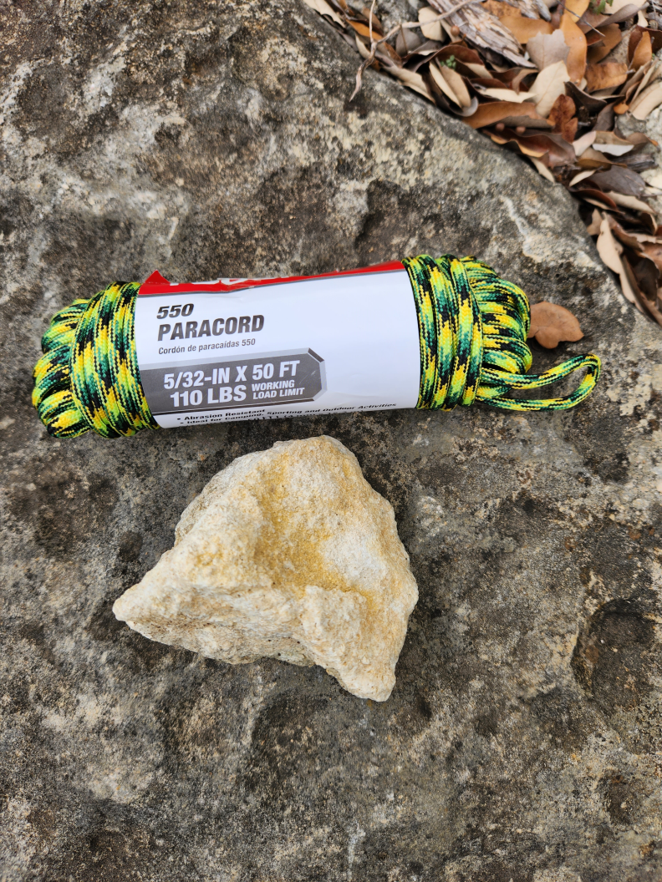
How we start

Slide 3
How we start
Pros
  Cheap
Cons
  Not terribly accurate
  Paracord snags in cedar
  Often lose the rock

Slide 4
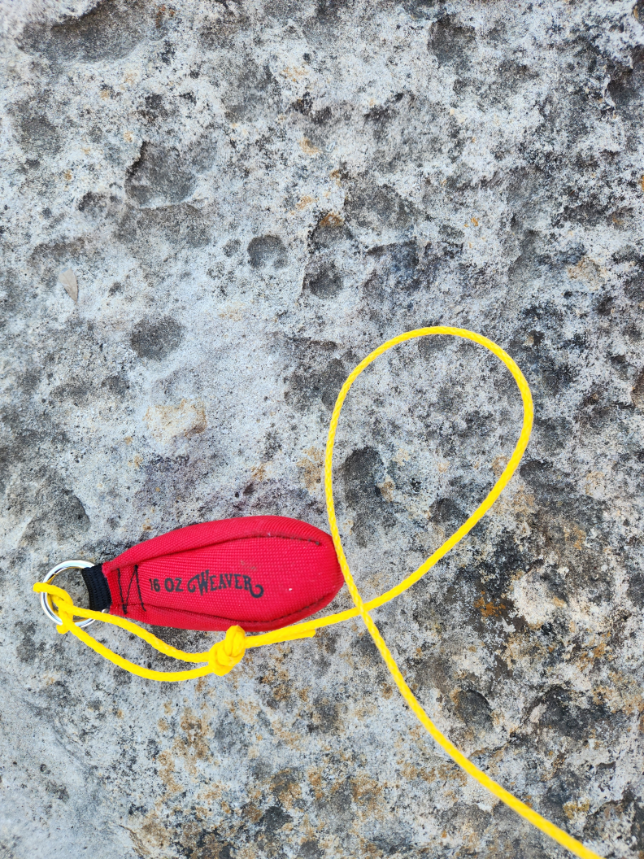
Next step

Slide 5
Next step
Arborist bag with polyethylene line
Pros
  Can be very accurate
  Polyethylene line does not snag on trees
Cons
  More expensive than paracord and a rock ($28)

Slide 6
Next step plus
Ben (K5AYR) came up with this tweak to the arborist bag. Using an extendable fishing pole, it was possible to place the bag over a specific branch at 25’ with great ease.
The fishing pole is also useful for threading an antenna through branches. Make sure the antenna has enough tension, then use the fishing pole to move the antenna back and forth through the limbs till it clears the tree. Fast and easy.

Slide 7
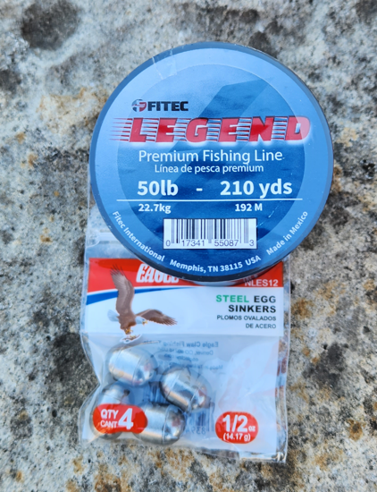
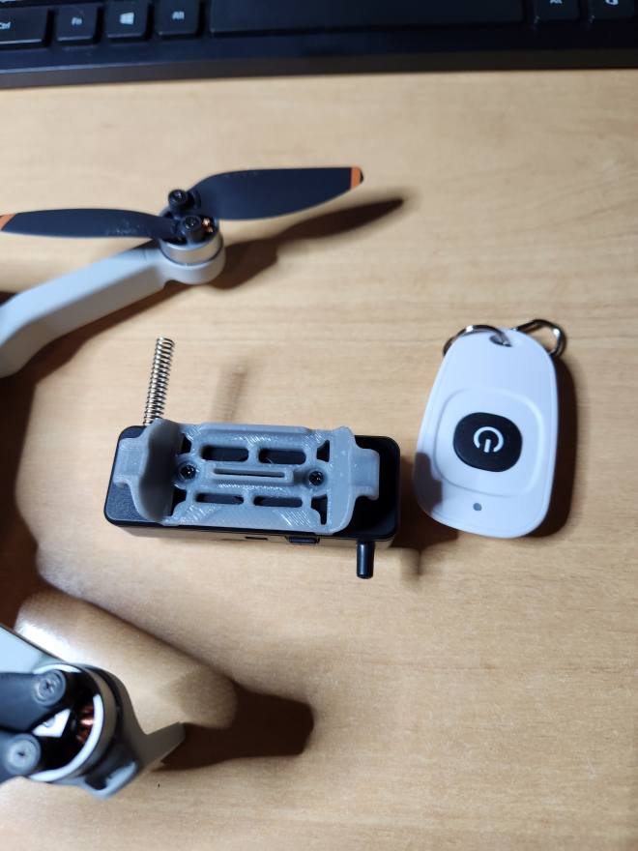
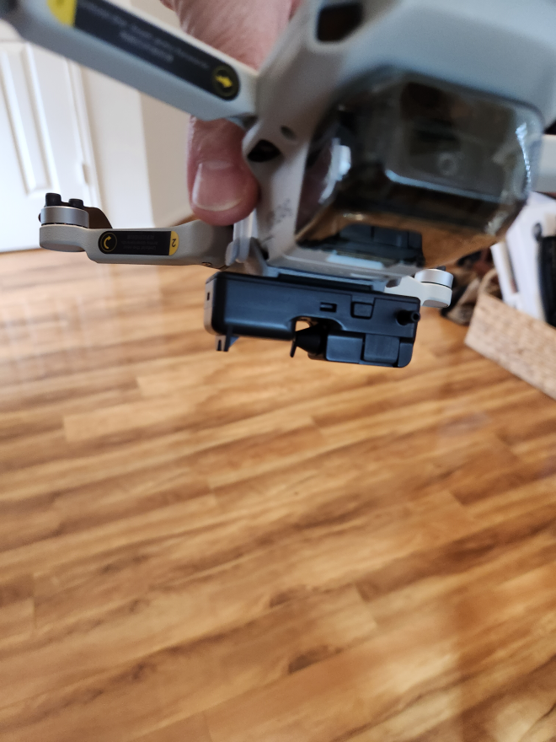
Final solution

Slide 8
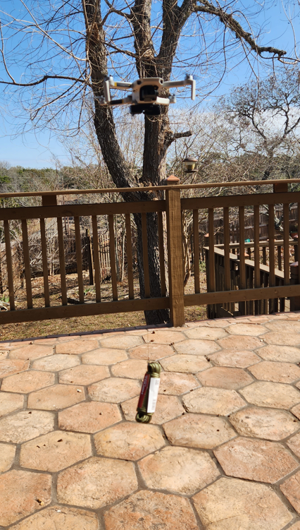
Final solution
Payload delivery device with a drone. Used for fishing with a drone (or dropping grenades from drones in the Ukraine). Mini drone can lift 50’ of paracord.

Slide 9
Final solution
Attach weight to monofilament
Put a loop into the monofilament to attach to delivery device
Fly to twice the height of the tree (drone has altitude display).
Fly over the tree
Drop weight. Tie polyethylene line to monofilament, and pull through tree.
Attach antenna to polyethylene line and pull antenna up.

