Slide 1
Community, County, State Service
Amateur Radio Communications in Times of Need
CERT, ARES, RACES

Slide 2
FEMA – Community Emergency Resource Team CERT
CERT educates & trains volunteers about disaster preparedness for hazards that may occur where they live

Slide 3
CERT Training
Disaster Response Skills
Fire
Light Search & Rescue
Team Organization
Disaster Medical Operation
WEB – www.community.fema.gov

Slide 4
ARRL – Amateur Radio Emergency Service ARES
ARES consists of Amateur Radio licensees who have voluntarily registered their qualifications and equipment for communications duty in the public service when disaster strikes. Training is required to participate fully in ARES.

Slide 5
ARES Required Training
ARRL – EC-001-S
FEMA – IS-00100.c
FEMA – IS-00700.b
Web – www.arrl.org

Slide 6
Texas Department of Emergency Management TDEM Radio Amateur Civil Emergency Service RACES
The FCC has authorized emergency management organizations to officially organize and employ radio amateurs to supplement state and local government communication systems during emergencies or disaster operations.
FCC Part 97 (97.407) allows RACES Ham Operators to operate in Civil Emergency Service should the FCC temporarily close all Amateur Radio Bands from normal operations.

Slide 7
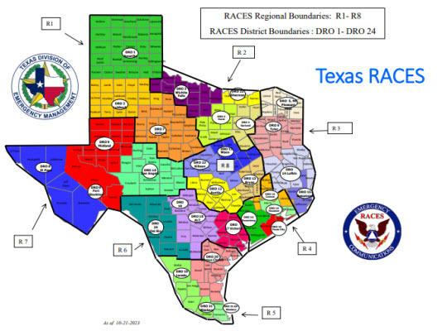

Slide 8
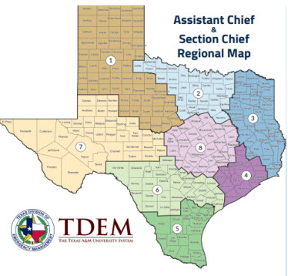

Slide 9
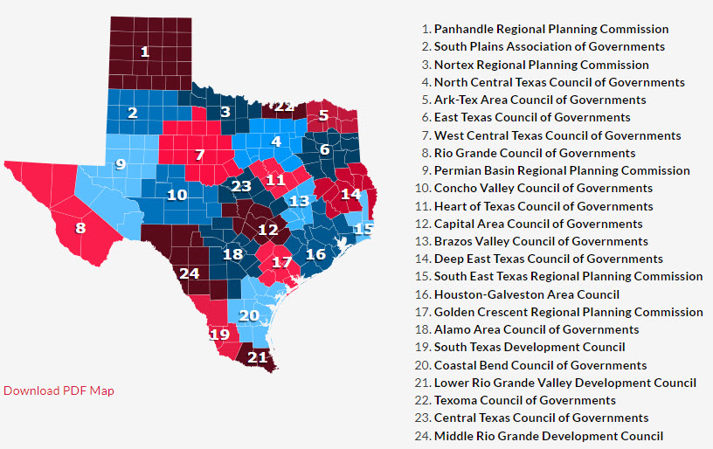
Texas Council of Governments

Slide 10
Texas RACES Membership
WEB www.tdem.Texas.gov/Response/RACES

Slide 11
EmComm- Training
WEB – www.wmcomm-training.org

